Slide 1
HAPL Concrete Shielding Requirements
Mohamed Sawan
UW Fusion Technology Inst.
HAPL Project Meeting
UW-Madison
October 22-23, 2008

Slide 2
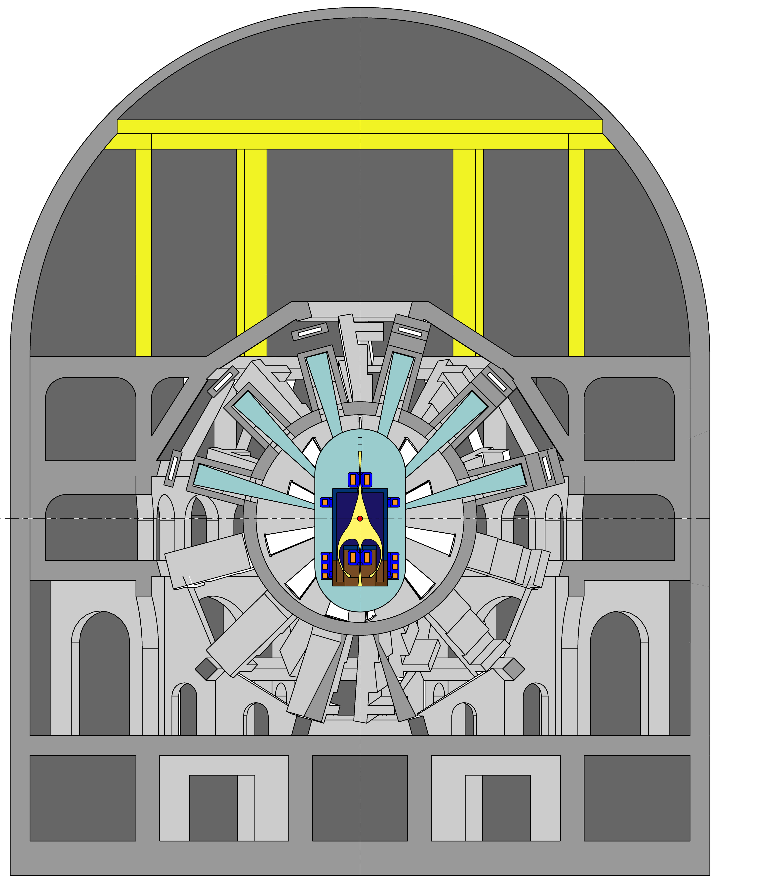
Concrete Shielding Configuration
Beam Duct Shield
Containment Building
Bio-shield
Arch Structural Support

Slide 3
Past HAPL Concrete Shielding Approach
Concrete bio-shield around final optics and chamber was determined previously assuming that access is allowed outside it during operation
This led to a sizable bio-shield
Adding the concrete containment building and concrete arch structural support results in significant amount of concrete

Slide 4
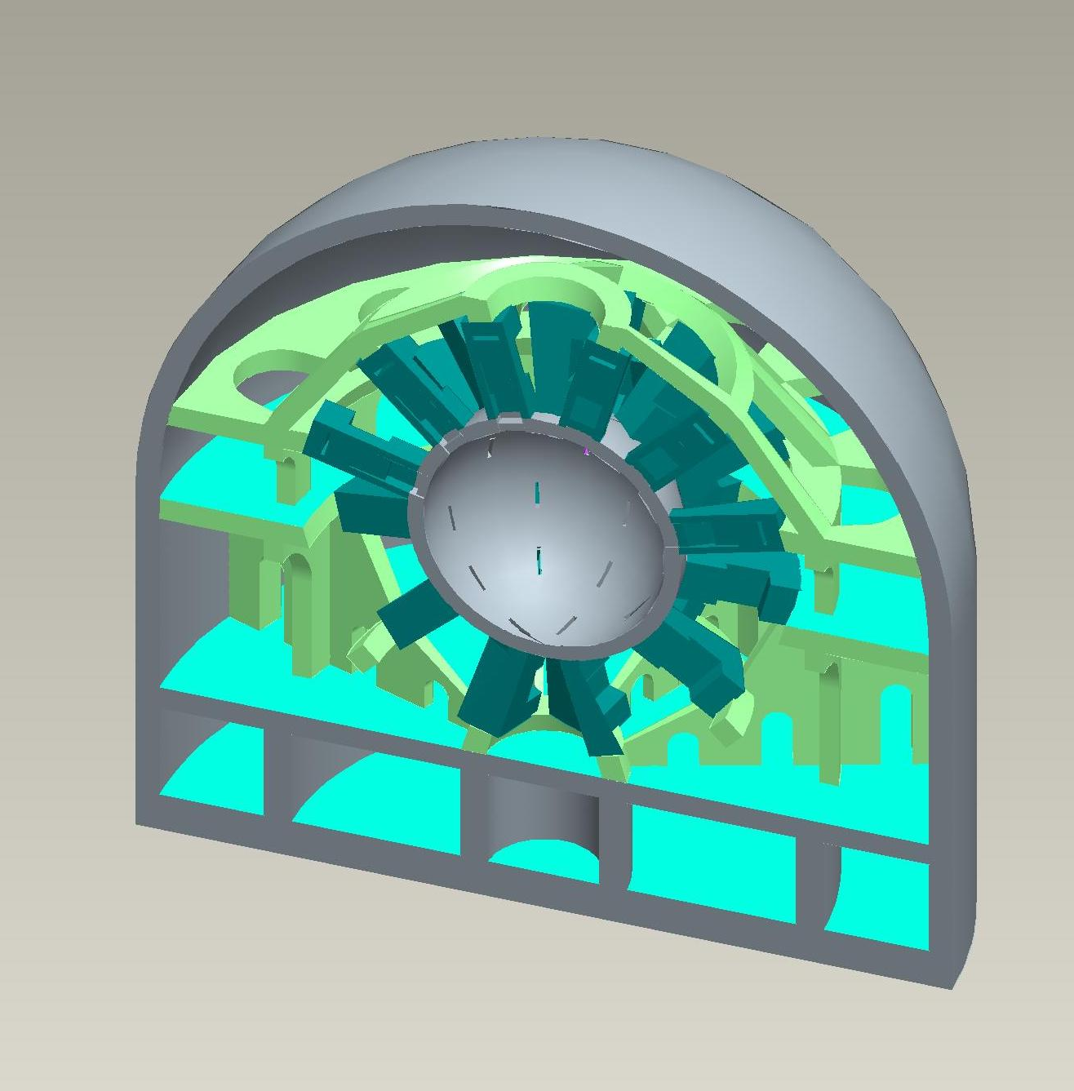
Previous HAPL Concrete Shield Dimensions
~400,000 m³of concrete
2.5 m inner spherical bio-shield around chamber
3.8 m containment building
From T. Kozub, C. Gentile, I. Zatz, et al., “Concepts and Requirements for GIMM Structures,” April 2008 HAPL meeting

Slide 5
Current HAPL Bio-Shielding Strategy
Access inside containment building allowed only for maintenance during shutdown periods
Inner bio-shield around chamber and final optics sized to yield acceptable dose of ~2.5 mrem/h about one day after shutdown
Containment building sized to yield an acceptable occupational dose to workers of ~0.5 mrem/h during operation
Even with these conservative dose limits significant reduction in amount of concrete can be achieved

Slide 6
Required Inner Bio-Shield
Past experience showed that if fast neutron flux (E>0.1 MeV) is limited to ~5x10⁵ to 3x10⁶ n/cm²s during operation, dose rate levels of ~2.5-10 mrem/h after 1-10 day cool down period will result from decay gamma of activated shield and outlying equipments allowing for hands-on maintenance
To get conservative estimates we use 5x10⁵ n/cm²s fast neutron flux limit during operation to determine required inner bio-shield thickness that allows for hands-on maintenance

Slide 7
Required Inner Bio-Shield (Cont.)
  Required inner bio-shield around chamber determined for two blanket options:
    80 cm LiPb/SiC blanket, 10 cm SS/water VV
    100 cm Flibe/Be/SiC blanket, 10 cm SS/water VV
Largest shield required at the neutron trap behind the GIMM where no shielding credit is provided by blanket and VV
Required shielding around final optics estimated from map of fast neutron flux around laser beam line

Slide 8
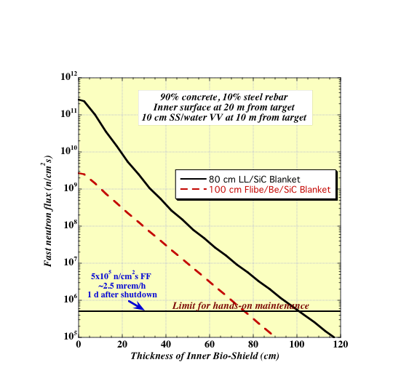
Required Inner Bio-Shield behind Blanket/VV
Assumed inner surface at 20 m from target
Type 04 ordinary concrete used with SS316 rebar
Required inner bio-shield thickness behind LiPb blanket is ~1 m and reduces to only ~0.75 m with Flibe blanket
A conservative 1 m thickness is recommended

Slide 9
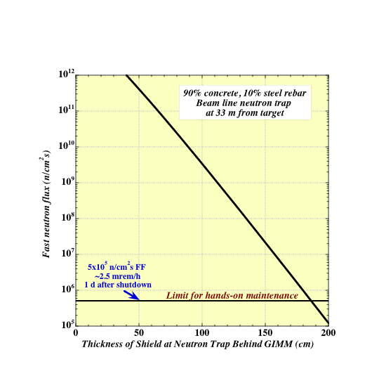
Required Bio-Shield at Neutron Trap behind GIMM
Required bio-shield thickness at neutron trap (@33 m from target) behind GIMM is ~1.85 m
Conservative thickness of 2 m is recommended

Slide 10
Required Bio-Shield Around Final Optics
M3
M2
0.3 m shield
0.5 m shield
Bio-shield thickness at GIMM is 1 m and reduces to 0.5 m around M2 and 0.3 m around M3
Shield at neutron trap should be 2 m at back and 1.5 m at side
2 m shield
Fast Flux (n/cm²s)
1.5 m shield
SiC GIMM
1 m shield

Slide 11
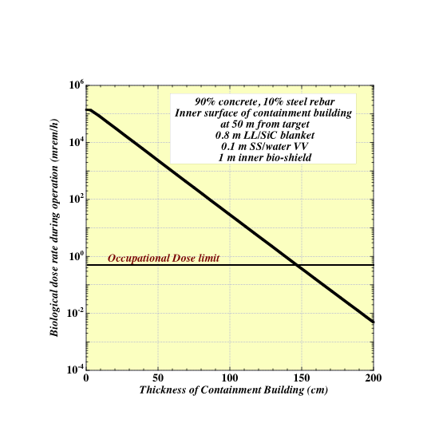
Required Containment Building Thickness
Assumed inner surface of containment building at 50 m from target
Type 04 ordinary concrete used with carbon steel C1070 rebar
Required containment building thickness is ~1.5 m
Since no credit is taken for added shielding by concrete arch structure, we can use thinner containment building

Slide 12
Summary and Conclusions
Amount of concrete required for bio-shield and containment building can be reduced significantly (by at least a factor of 2) based on shielding requirements
Considerations for structural support might dictate using thicker bio-shield and containment building than required for radiation shielding

